Slide 1


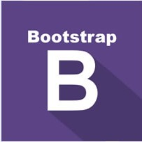

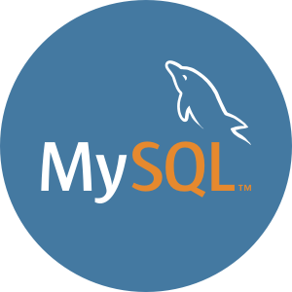
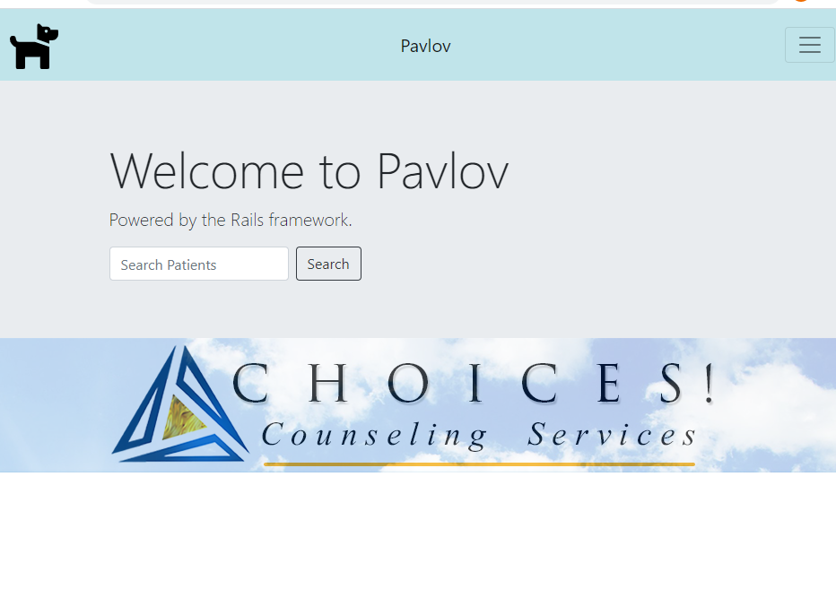
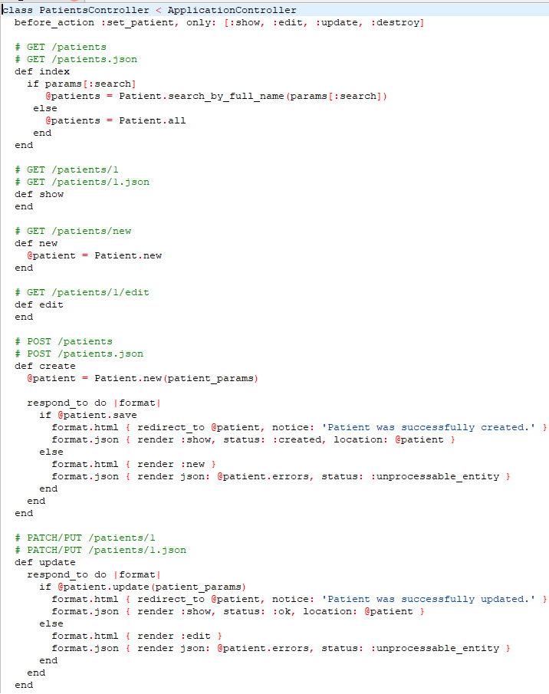
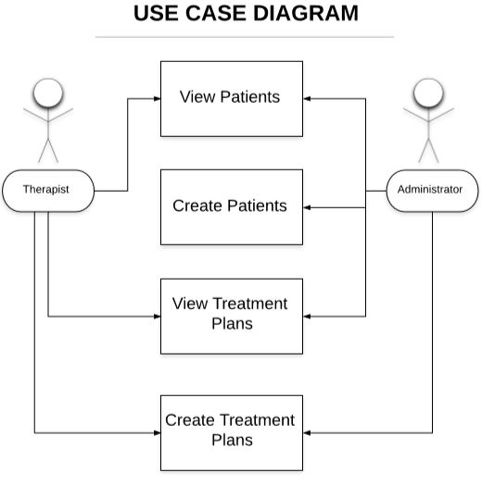
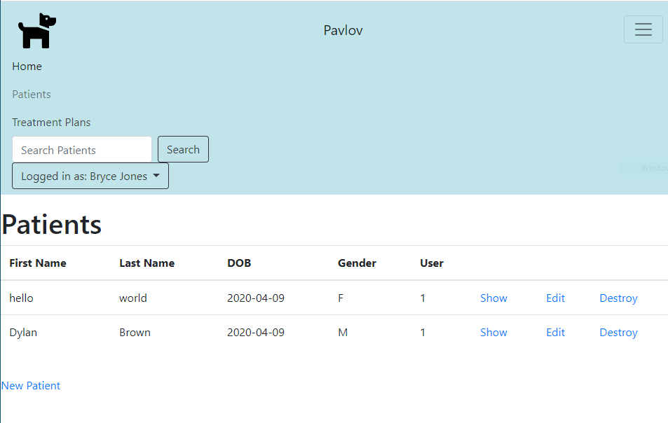

Choices! Counseling Services Database
Pavlov Team – Kenyona Parker – Dylan Brown – Abby Palmer – Bryce Jones – Deven Harris
Abstract
This project is implementing and deploying a functional patient database with customizable treatment plans and progress notes for Choices!, a counseling service center.
To build this application and support the various requirements, several frameworks were considered for this project including Django, Flask, and Ruby on Rails.
Existing libraries within Rails allow for a choice of several database engines; MySQL, Postgresql, MongoDB, and NoSQL were considered. MySQL was adopted as a result of the extensive documentation and for continuity with the previous solution. The Ruby on Rails suite was selected for reasons of existing familiarity for the team.
Front-end requirements were met with a combination of HTML and Javascript, linked to a Bootstrap 5 framework in order to streamline user accessibility.
A key quality desired by the customer was ease-of-use, to encourage higher efficiency and easy adoption by the stakeholders.
In the process of development, secure data handling also emerged as a further and highly-desired attribute.
Platforms and Tools
Ruby on Rails (with MySQL database)
JavaScript
HTML 5
Bootstrap 5
https://www.javascript.com/
https://html.com/
https://getbootstrap.com/
https://rubyonrails.org/
https://www.mysql.com/
The first image is the Welcome Page to the Pavlov database, the second image is the Patients screen to view, edit, delete and search. The third image is the code for the Patients screen.
Additional Features
Future Work
Created google forms that are able to be uploaded for treatment plans
Login in screen with password
Added ability to create progress notes based on information previously recorded in the creation of patients and treatment plans
Implementing the real data from the counseling database into the system to be used
Authorizing access to real users in the counseling staff
Added security in accessing data for both viewing and manipulating for patient confidentiality
Challenges
System was built to be a potential successor to a currently deployed solution, but source code and design/specifications were unavailable
Circumstances including the COVID-19 situation required rapid changes to team practices due to dispersal of team and move to network-based communications
Some features required significantly more complexity and customization capability than originally anticipated; individual treatment plan templates in particular required architectural changes
Acknowledgements
Professor Paula Dranger, MSW, LCSW, MAC
Professor Nick Rosasco, DSc
Notes:
,

